Slide 1
Poker Hand Strength Prediction
Based on UCI Poker Hand Data Set
Group Members:
Engy Abdel Azeez
Armin Jamshidi
Samira Kazemi
Shahzeb Shahid

Slide 2
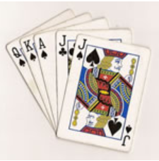
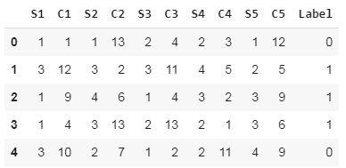
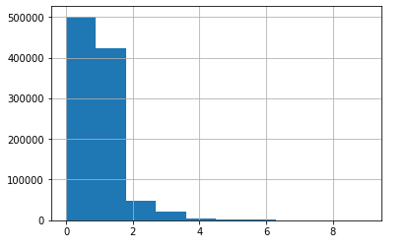
Introduction
Associated Tasks | Number of Instances | Number of Attributes | Area | Missing Values
Classification | 1025010 | 11 | Game | No

Slide 3
Models
Models | Accuracy
 | CV=3 | CV=10
RandomForest | 57.6% | 58%
KNN | 54.76% | 54.83%
SVM | 56% | 55.7%
Adaboost | 51.3% | 49.1%
Gradient Boosting | 88.72% | NA
Bagging | 60.9% | 59.9%
MLP | 99.34% | NA

Slide 4
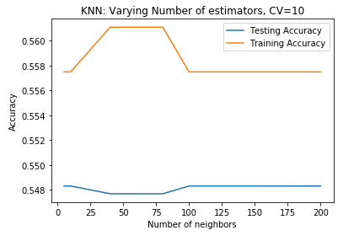
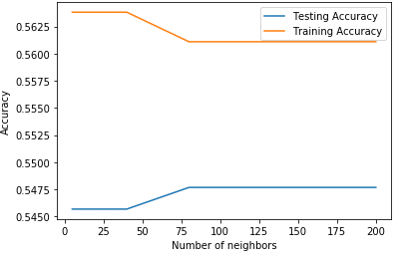
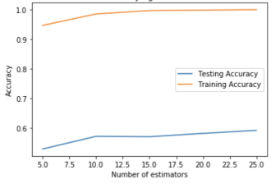
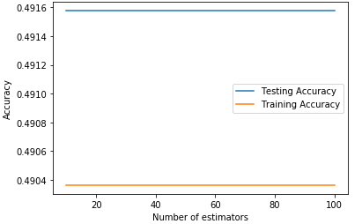
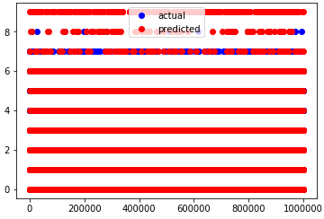
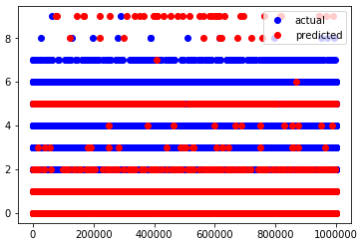
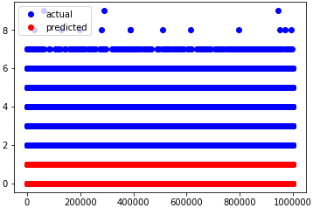
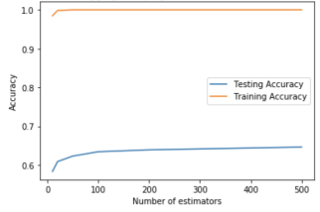
Model Plots
KNN: Varying Number of Neighbors, CV=10
KNN: Varying Number of Neighbors, CV=3
RandomForest: Varying Number of Estimators
AdaBoost: Varying Number of Estimators
MLP: Varying Number of Estimators
SVM: Varying Number of Estimators, CV=3
SVM: Varying Number of Estimators, CV=10
Bagging : Varying Number of Estimators

Slide 5
Comparisons with other research
Relevant papers have shown poor accuracy when not using Neural Network Classifiers
Gradient Boosting method produced 88.72% accuracy
Gradient descent method produced 50% accuracy (1)
Naïve Bayesian method produced 56.68% accuracy (2)
Neural Network Classifiers produce high accuracy results
MLP method produced 98% accuracy
Produced over 90% accuracy (1)
RAGA method produced 99.96% (3)
Gökay Dişken, Predicting Poker Hand’s Strength With Artificial Neural Network. Adana Bilim ve Teknoloji Üniversitesi.
Gaurav Ambekar, Shiben Sheth , Abhilasha Sable, Tushar Chikane, Kranti Ghag. Anticipation of Winning Probability in Poker Using Data Mining
Cattral, R. RAGA: Rule Acquisition With A Genetic Algorithm. Masters thesis, Carleton University, Ottawa, Ontario, Canada, 2001. ISBN: 0612577589

Slide 6


Final Note
The only non Neural Network approach that produced high level of accuracy was Gradient Boosting
Best approach to address Poker hand is the MLP Neural Networks method
Neural Networks are used for sport analytics and gambling prediction

